Slide 1
Computers for Christmas

Slide 2
Welcome and thank you for your interest

Slide 3
Requirements:
You will need to:
Be based in the UK.
A constituted non-for-profit organisation.
Work directly with service users - You cannot give it to another organisation.
Have at least two social media accounts, either X, Facebook or Instagram.
Follow us on your social media accounts.
Be able to make two videos and one post.

Slide 4
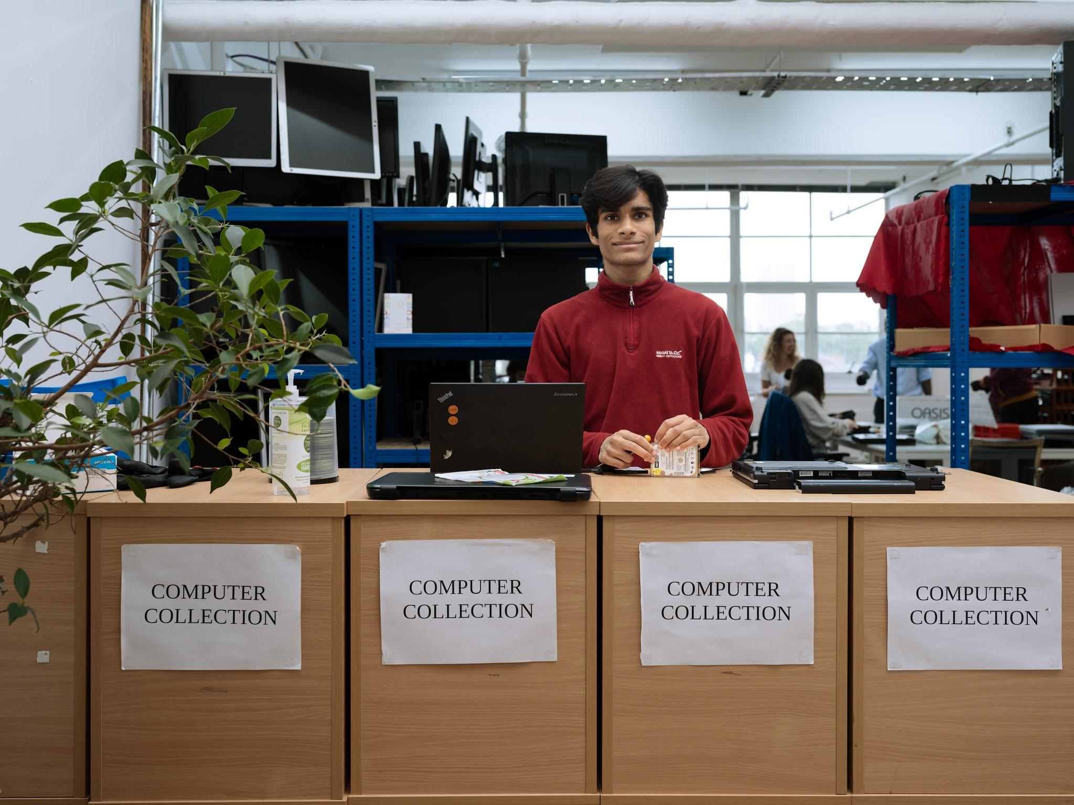
The Equipment:
We will be donating a minimum of 10 devices per organisation, 6 desktops with monitors, keyboards and mice and 4 laptops.

Slide 5
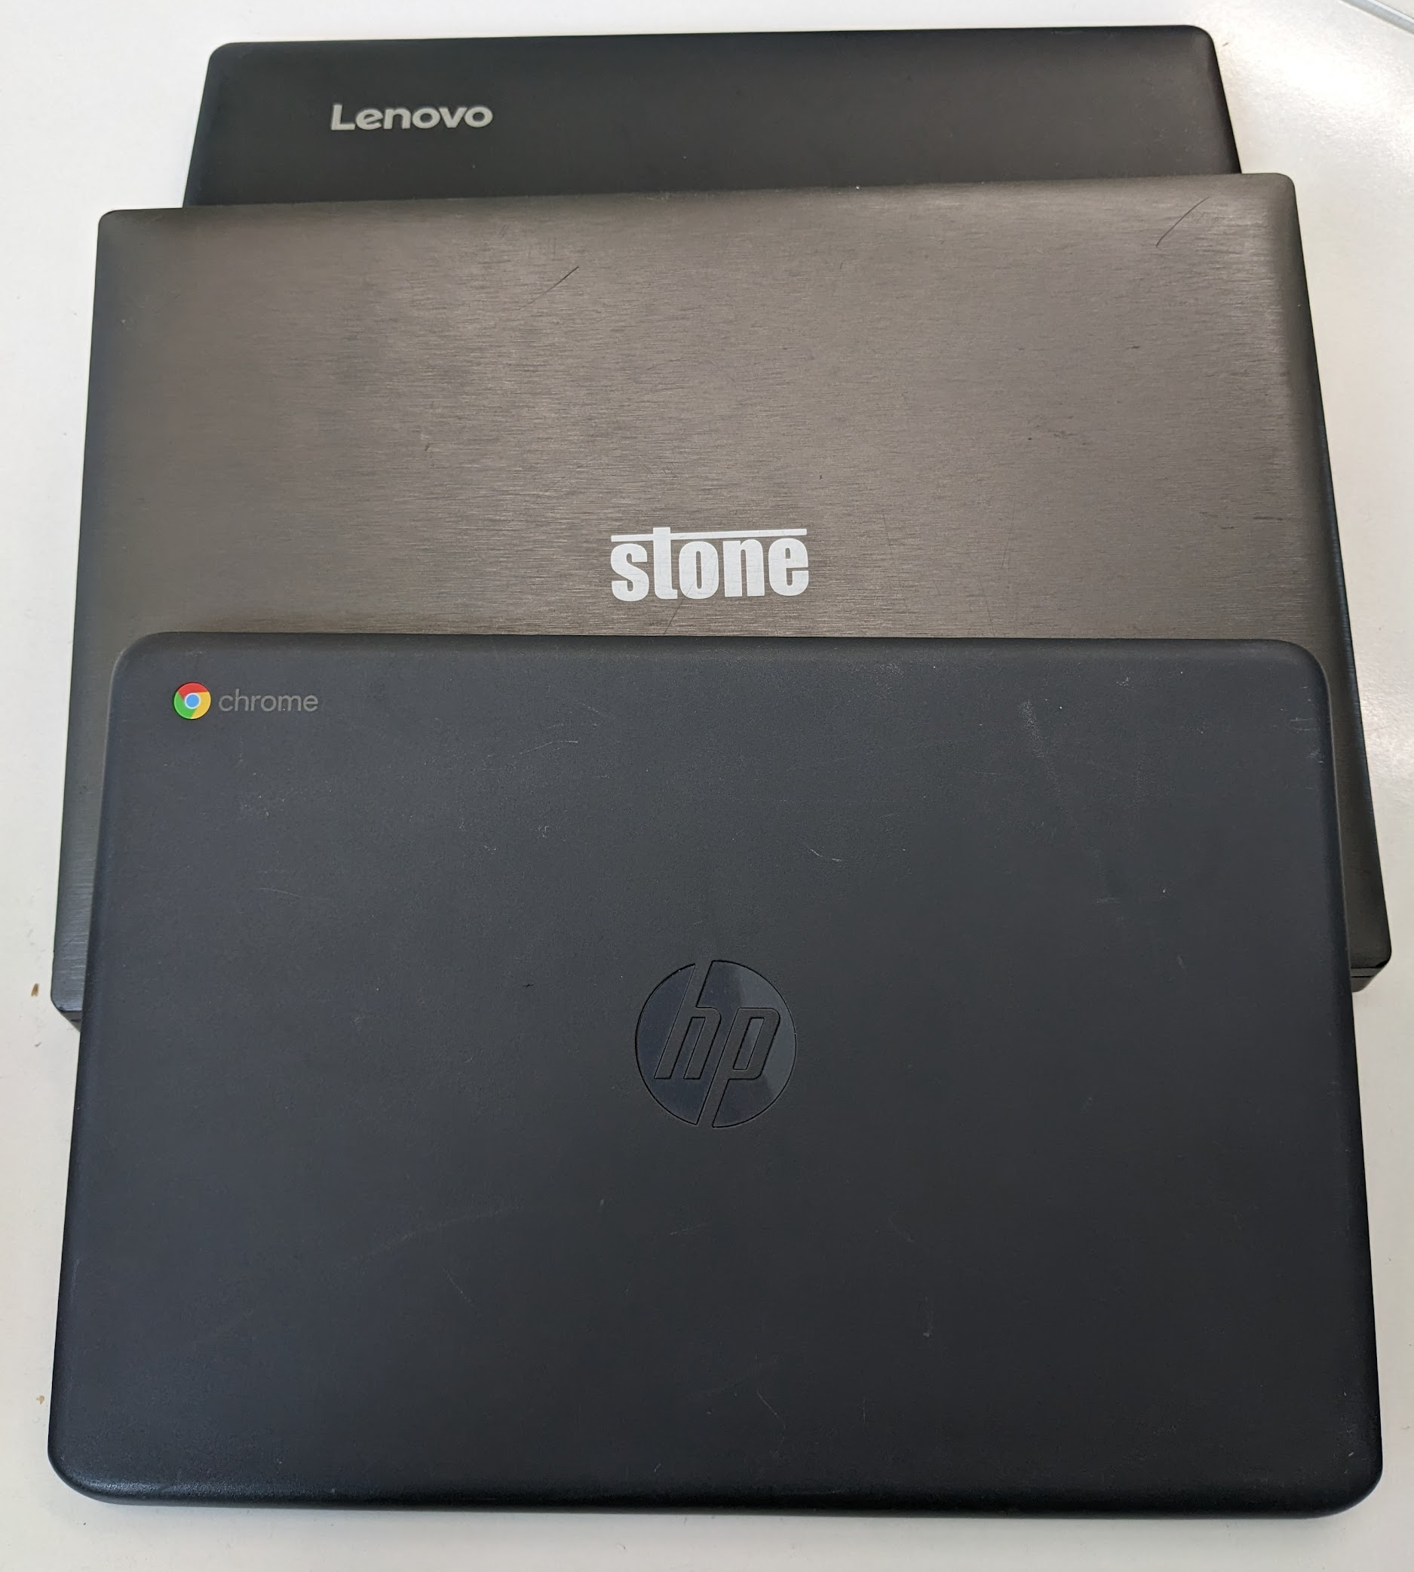
The Equipment:
Our minimum specification is 8GB of DDR3 RAM.
Both laptops and desktops will be of different sizes, but able to run Windows 10.
Everything will come ready to go. Users will just need access to the Internet

Slide 6
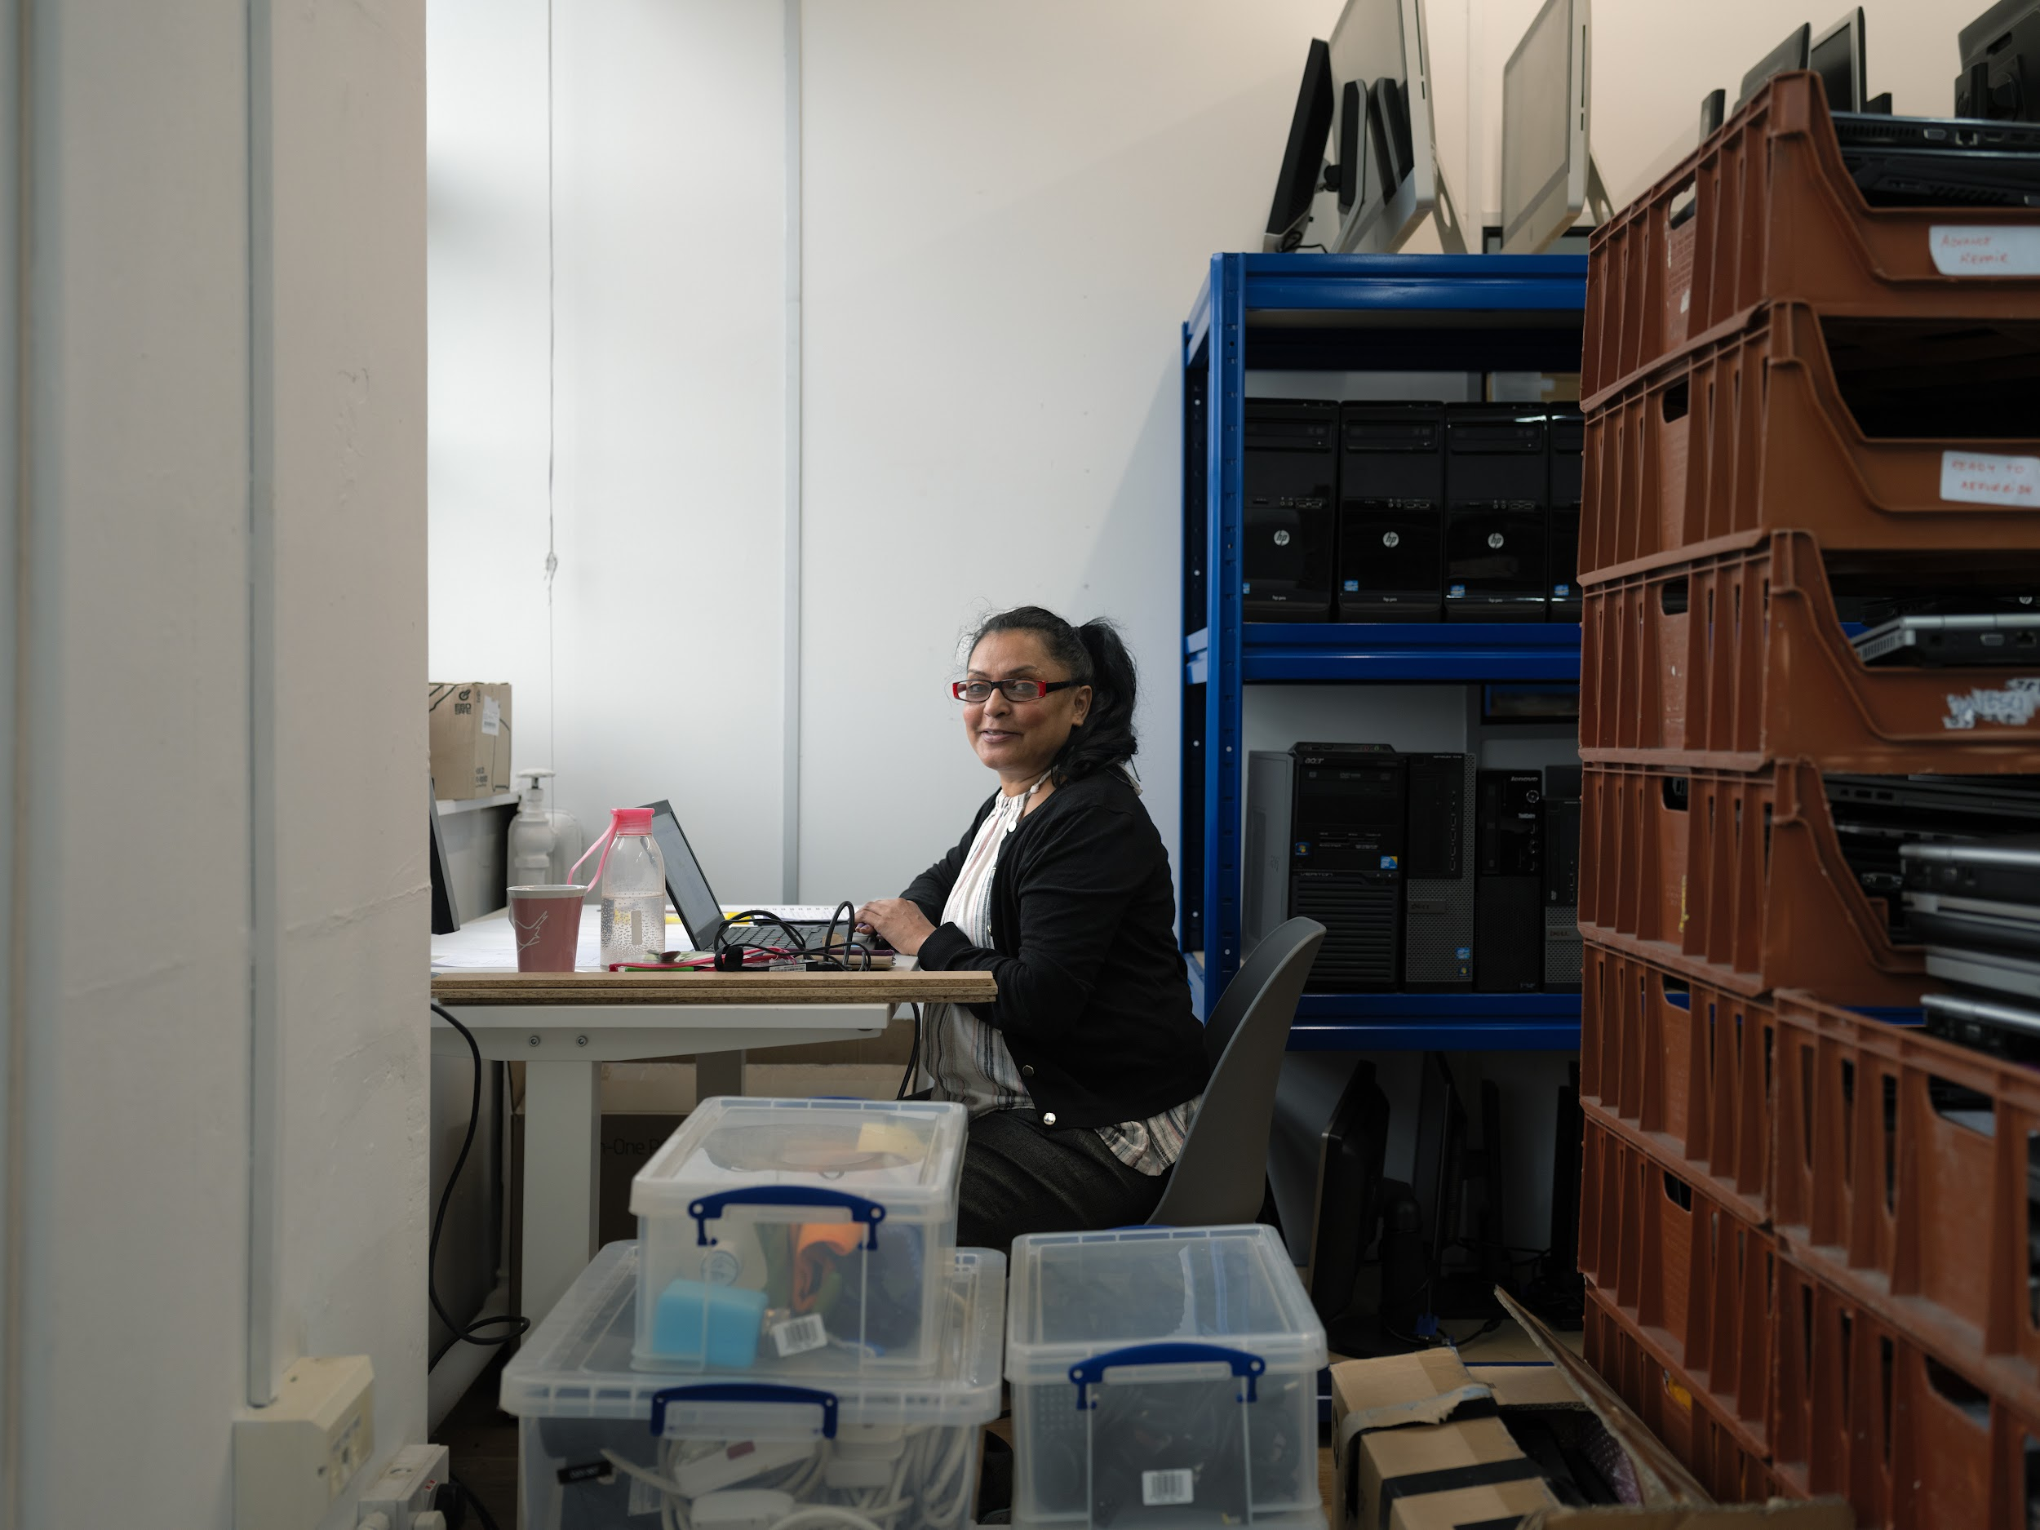
Who can use it?
This winter will be challenging for everyone, including organisations and community centres. We are happy for your organisation to use up to 50% of this donation to upgrade your computers. Just let us know.

Slide 7
Post 1 - Promote the campaign in your social media channels.
A post will appear in our page, for you to download, together with the link to the funding application.
Make sure you post it in at least two of your social media channels, either X (Twitter), Instagram or Facebook.
With this message:
#Thanks to @meritorg @fbc_clerkenwell @digipovalliance
#Thanks to @meritorg @fbc_clerkenwell @digipovalliance

Slide 8
Post 2 - Let us know who you are and why computers will change lives
Let us know a bit of what you do and why computers are important to you or your service users.
Make sure to tag us: @meritorg

Slide 9
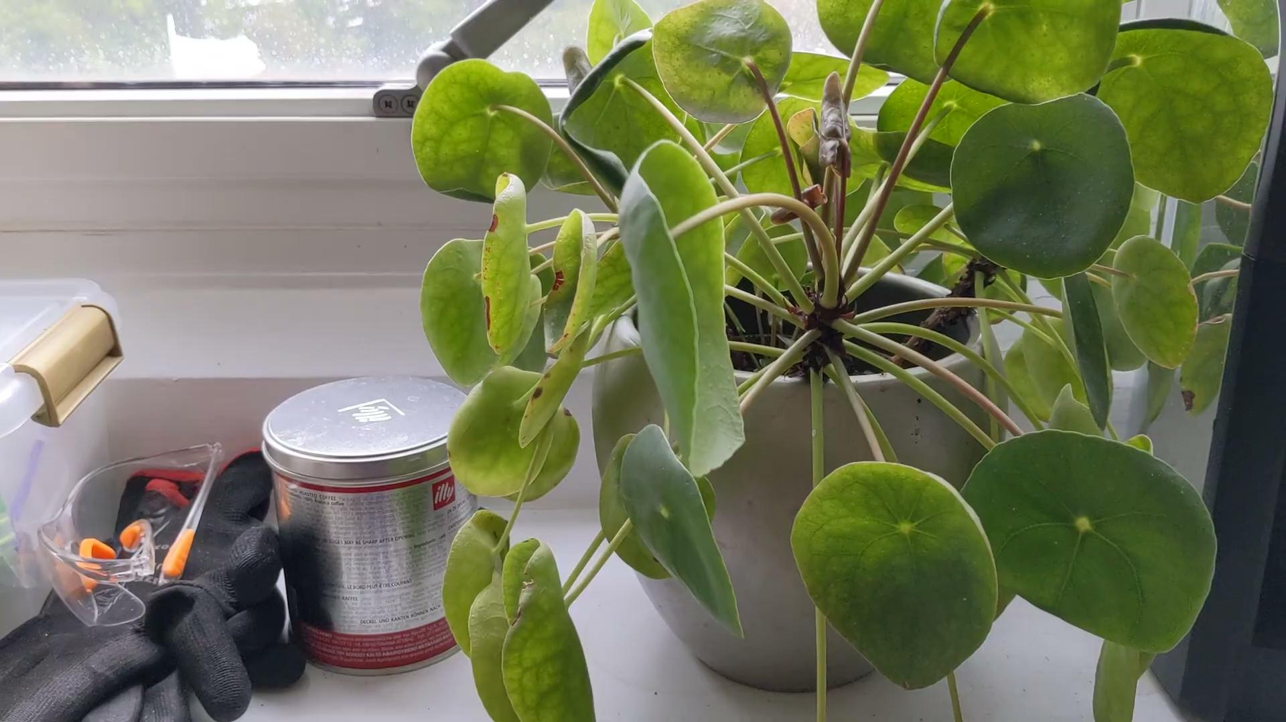
Video 1 - You will need to upload one video as part of your application. Tell us how Digital exclusion impacts your service users.
Talk to us about your experience of digital inclusion. a computer and the impact it will have on the lives of your service users.
We recommend about 30 sec
Please note that Mer-IT will be using this content for marketing purposes, so do not include anything confidential.

Slide 10
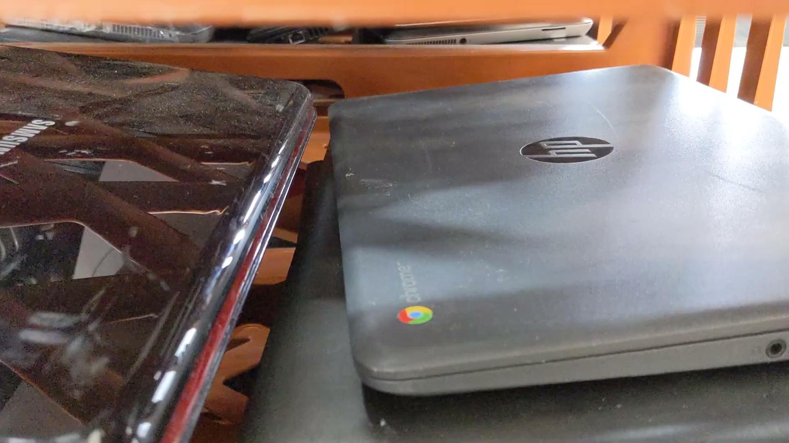
Video 2 - As part of your report. You will need to give us an example of the impact that the grant has had.
Let us know how the grant has benefitted your organisation. Ideally you can talk about a service user, ideally they can talk for themselves, but this is not necessary.
You will need to post the video and send it to us as part of your report.
Please note that Mer-IT will be using this content for marketing purposes, so do not include anything confidential.

Slide 11
Time for questions:
Q & A

